Slide 1

Analyzing Key Factors in Traffic Accidents: A Data-Driven Approach
This presentation examines traffic accident data through advanced analytics. We identify key factors contributing to accidents and develop predictive models.

Slide 2
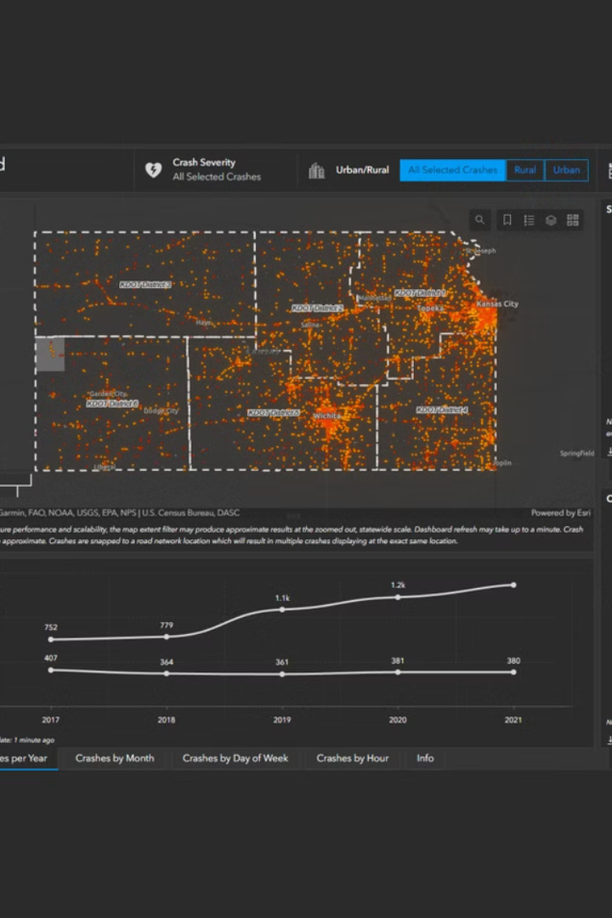
Executive Summary
Global Concern
Project Scope
Road accidents cause major loss of life worldwide. Data analysis can help identify preventative measures.
We analyze real-world traffic data to identify accident causes, predict severity, and recommend safety improvements.
Technical Approach
Our methodology employs Python, machine learning models, visualization techniques, and feature engineering.

Slide 3




Problem Statement
Multiple Factors
Traffic accidents result from various elements: weather conditions, vehicle speed, road quality.
Limited Research
Most existing studies focus on isolated variables rather than integrated approaches.
Our Approach
We aim to develop a comprehensive model predicting accident severity using multiple features.

Slide 4








Project Objectives
Analyze Trends
Build Models
Examine accident patterns across different time periods and geographic regions.
Develop predictive machine learning models to forecast accident severity.
Recommend Solutions
Identify Risk Factors
Determine high-risk conditions that contribute to severe traffic accidents.
Propose evidence-based interventions to improve traffic safety.

Slide 5
Data Description & Cleaning
Dataset Source
Data Cleaning Process
Key Factors in Traffic Accidents (Kaggle)
Handled missing values through imputation
Key Fields
Detected and treated statistical outliers
Encoded categorical variables for analysis
Accident time and location
Standardized date/time formats
Weather conditions
Road quality indicators
Vehicle count
Accident severity metrics

Slide 6
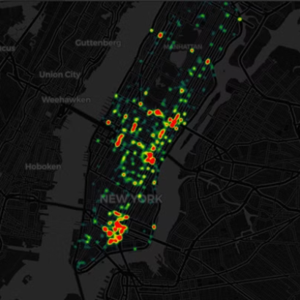
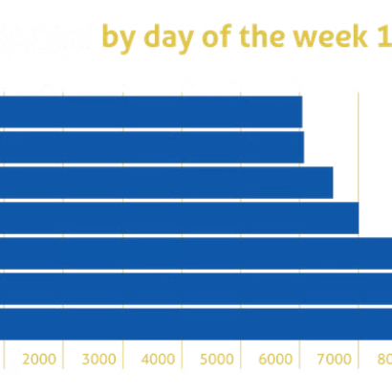
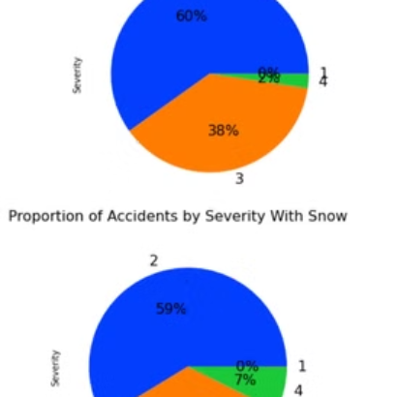
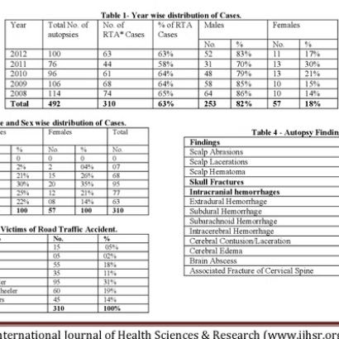
Exploratory Data Analysis
Our analysis revealed several key patterns. Poor pavement conditions, rain, and high speeds significantly increase accident severity.
Evening and night accidents occur more frequently. We found correlation between traffic fines and accident rates.

Slide 7

Feature Engineering
Custom Metrics Creation
Developed composite indicators like "Accident Impact" (Injuries + Fatalities).
Data Normalization
Applied MinMaxScaler to numerical variables for consistent model training.
Feature Selection
Finalized 11 features: 9 numerical and 2 categorical variables.

Slide 8




Machine Learning Models
Ensemble Method
1
Voting Regressor combines multiple models
Advanced Models
2
CatBoost, XGBoost, Random Forest
Classical Models
3
Ridge, Lasso Regression
Base Model
4
Linear Regression
We evaluated models using R² Score, Mean Squared Error (MSE), and Root Mean Squared Error (RMSE).

Slide 9
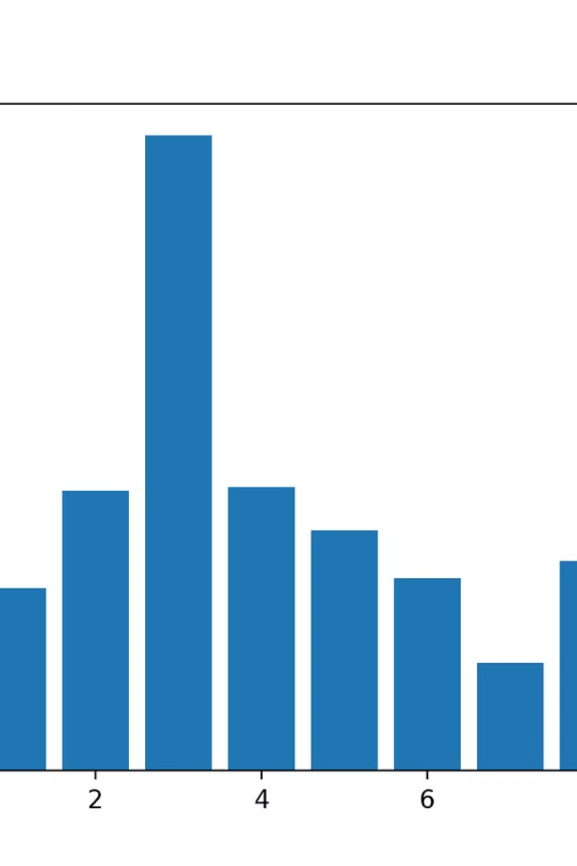
Model Results
0.8453
2.03
R² Score
RMSE
Voting Regressor model accuracy
Root Mean Squared Error
10
Cross-validation
K-fold validation passes
The most influential features were traffic light presence, vehicle speed, and total vehicle count.

Slide 10
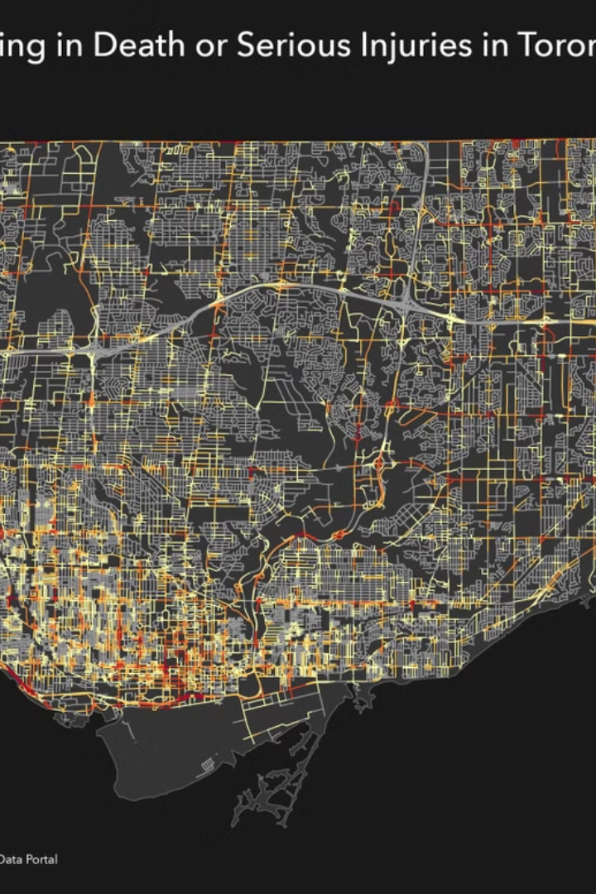
Geospatial & Temporal Insights
1
Urban Patterns
City centers show higher accident density, particularly at complex intersections.
2
Time Patterns
Peak accident times occur during evening rush hours and weekend nights.
3
Infrastructure Impact
Road design flaws correlate with specific accident hotspots.
4
Congestion Correlation
Traffic density shows strong relationship with accident frequency.

Slide 11





Recommendations
Infrastructure Improvements
Enhance road lighting and signage in urban high-traffic zones.
Speed Management
Implement stricter speed control measures where pavement quality is poor.
Traffic Signal Optimization
Adjust signal timing based on congestion patterns and accident history.
Public Awareness
Launch targeted safety campaigns for high-risk periods like weekends and rainy days.

Slide 12



Conclusion
Predictive Power
Machine learning effectively predicts accident severity factors.
Holistic Approach
Multivariable modeling provides comprehensive safety insights.
Real-World Impact
This research can save lives and support smart urban planning.

Slide 13

Thank You!

